Slide 1

MUSIC CHURN PREDICTION
Members
Samyukth Suresh
Garima
Dhruv
Sai
Presented by :
VamshiSai Perumandla - vp2361

Slide 2

Introduction
Many businesses now use a subscription-based business model for their growth
Churn analysis provides such companies with a better way of retaining their customers
Churn analysis helps a business understand the steps necessary for increasing profit
Churn may also apply to the number of subscribers who cancel or don't renew
Higher churn rate = More customers stop buying from your business

Slide 3

Problem Statement
Our goal is to help a fictional business (similar to Spotify and Apple Music) to actively identify users at the risk of churning in real time.
From a subscription perspective at any point, users do any of the following:
1. Upgrade from the free user to the paid user
2. Downgrade from the paid user to the free user
3. Delete their account and leave the service
We want to identify the users that could potentially delete their account and leave the service. By identifying this group, we could incentivize them by giving them discounts or other rewards.

Slide 4
Why is Churn Rate Prediction Important?
According to a survey, 34% of Americans say they’ll probably sign up to more subscription services over the next two years.
Big Players such as Netflix, Amazon, Google and Apple are concentrated on Refining the Subscription Experience for various services
Refining the subscription experience relies on effective collection, monitoring and use of customer data
Having the ability to accurately predict future churn rates helps business gain a better understanding of future expected revenue

Slide 5
Why Big Data?
Music apps deals with millions of users daily and provides subscriptions to most users, it will be really helpful to use big data to help grow and monitor the business
Netflix alone generates 500 million GB’s of data daily from their user
Companies like prime, netflix, and spotify collect data, such as a user’s watch history, search queries, and time spent using their service
Using advanced big data and analytics tools becomes crucial to deal with remarkably large datasets

Slide 6
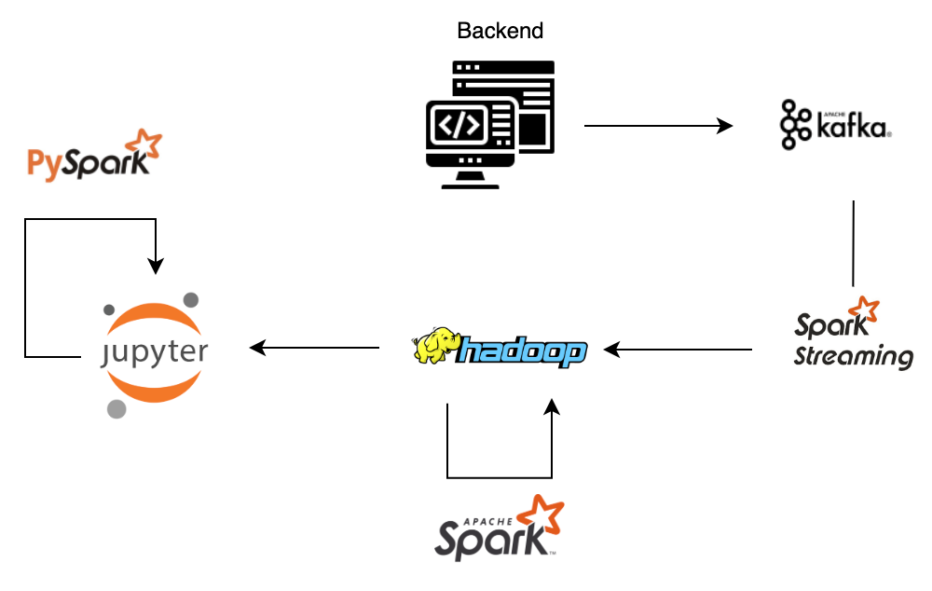
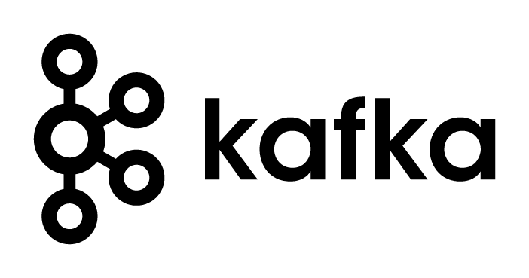

BIG DATA PIPELINE

Slide 7
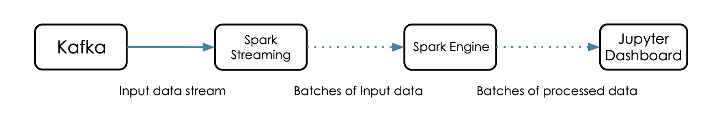
Why Kafka?
Kafka loads our real time user log data from backend with low latency.
Kafka is more reliable than similar messaging services available.
Apache Kafka is massively scalable because it allows the log data generated by the sparkify streaming app to be distributed across multiple servers
As a message broker, it lets applications publish or subscribe one or multiple event streams
Kafka replicates data and is able to support multiple subscribers
Notes:
Link for reference: https://www.codemotion.com/magazine/ai-ml/big-data/is-apache-kafka-still-relevant/

Slide 8
Why Spark?
Traditional technologies, such as relational databases, are not well suited for log data in real-time.
They are designed to store and process data in batches, which is slow and inefficient for large volumes of data that need to be processed in real-time.
In contrast, Spark/Spark ML and it’s ML libraries are specifically designed for handling and processing large amounts of data in real-time.
It is highly scalable, fault-tolerant, and can process data in parallel, which makes them well suited for handling the high-volume and fast-paced nature of log data.
Notes:
Link for reference: https://www.tutorialspoint.com/apache_kafka/apache_kafka_integration_spark.htm

Slide 9
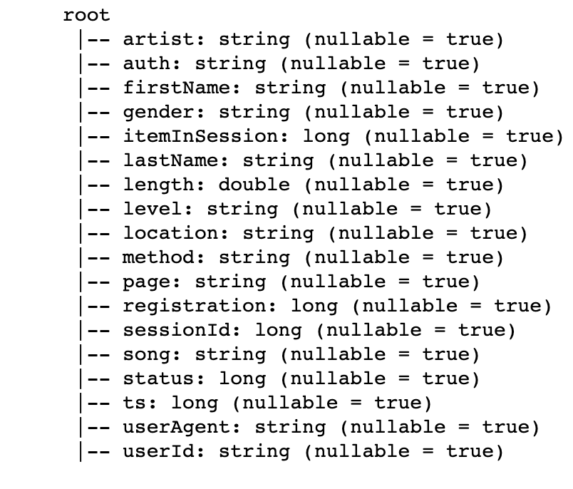
Our Dataset
We have a dataset with the following columns and schema
It is a JSON formatted data and has in total 26259199 number of records

Slide 10
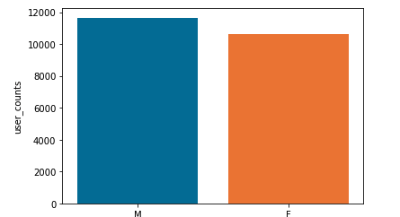
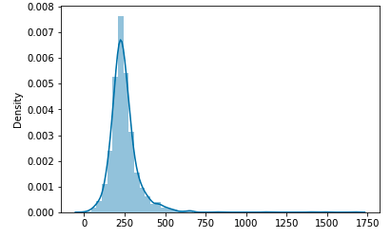
DATA EXPLORATION
GENDER RATIO
UNIQUE USER SESSIONS(LENGTH)

Slide 11
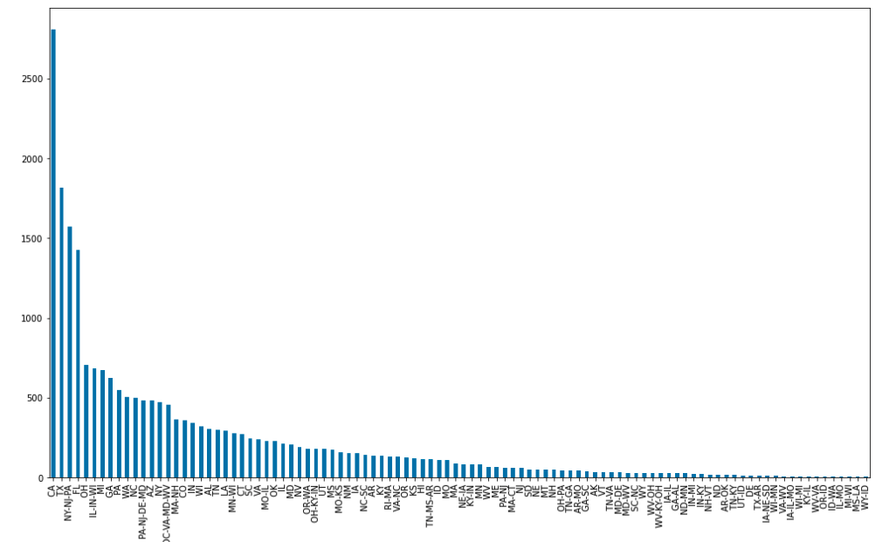
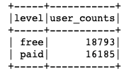
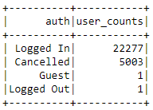
DATA EXPLORATION
FREE VS PAID CUSTOMERS
USER CHURN RATIO
LOCATION ANALYSIS

Slide 12
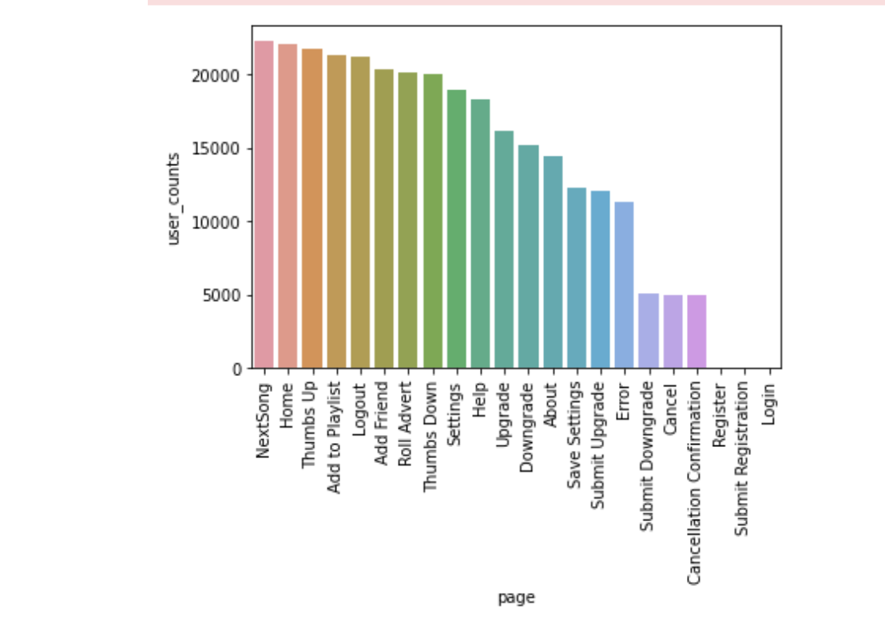
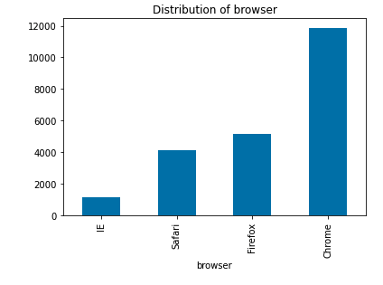
DATA EXPLORATION

Slide 13
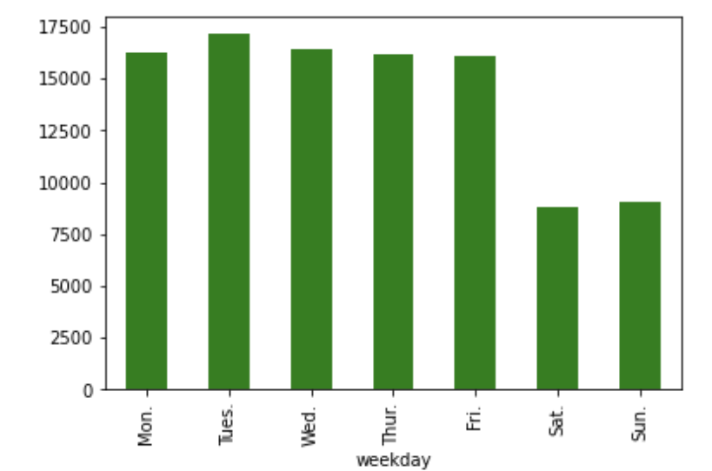
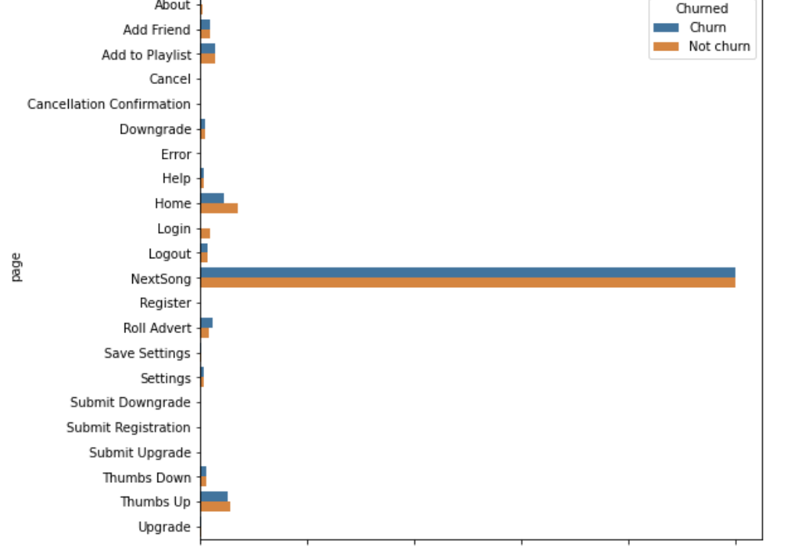
DATA EXPLORATION

Slide 14
Feature Extraction and Engineering
While dealing with large amounts of data it is important to know which features will be important for our churn rate as we cannot have unnecessary data taking up memory/time and affecting our results
An intuitive example can be columns such as first name and last name are not relevant and should be discarded while features like time spent on the app can be crucial for our churn prediction
Now, feature extraction is also an important step. As said earlier time spent on app can be crucial but time spent is not directly implied by our dataset. So, we have to extract such features from timestamp column
In this way we have tries to extract relevant data from existing columns to get number of likes and dislikes, number of errors, sharing activity etc

Slide 15
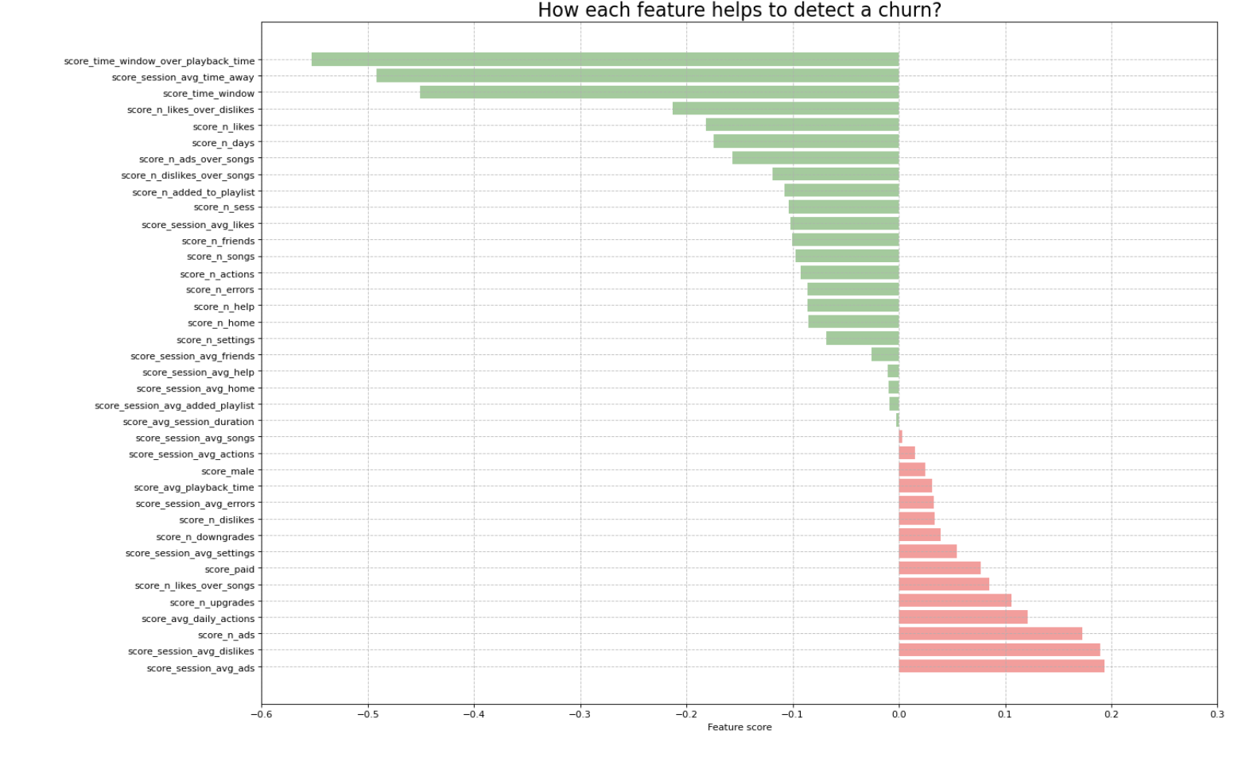
FEATURE EXTRACTION AND ENGINEERING

Slide 16
Model Training and Testing
For Model we select four models to train and test our data and select the best model out of the four
Linear Regression, Decision Tree, Random Forest, Gradient Boost
For our model we have few important metrics like recall, F-score and AUC
Recall cares about our positive predictions as that will decide the organizations next steps towards the prediction
To balance the negative predictions we also care about the F-score because we cannot end up sending discount coupons to everyone and end up affecting our revenue
We also use AUC, area under the curve which allows us to plot true positive against false positives

Slide 17
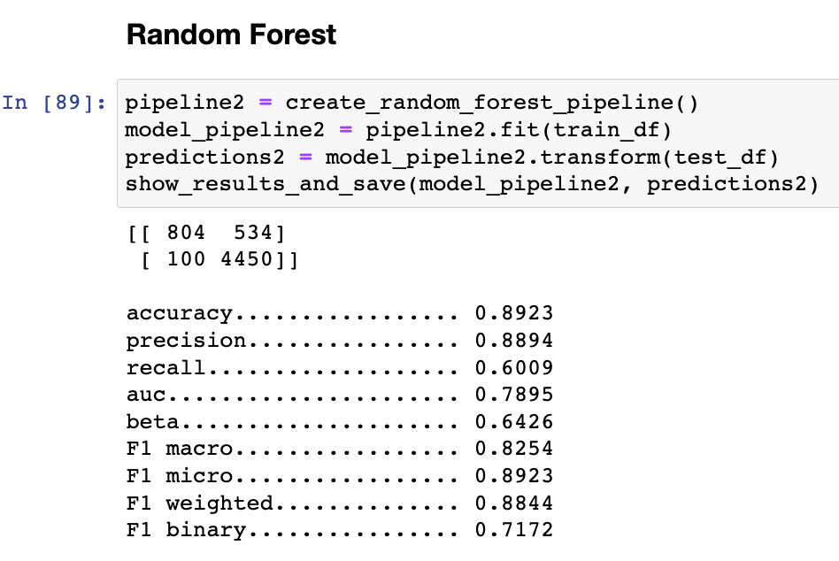
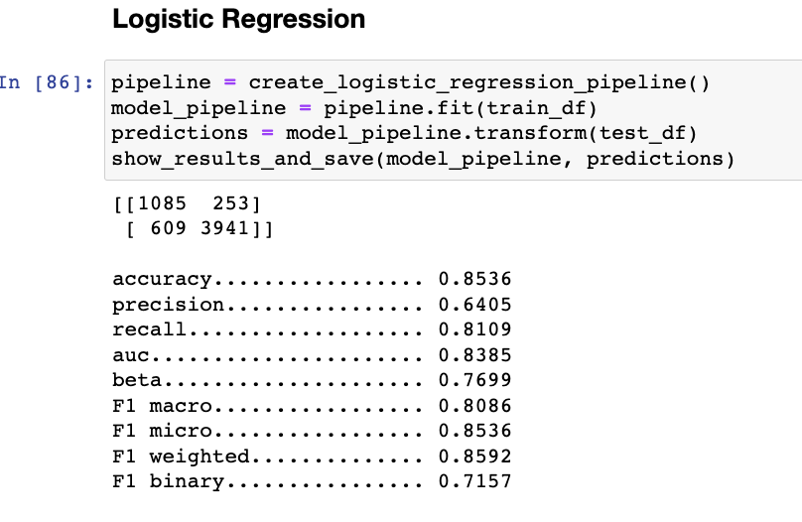
RESULTS

Slide 18
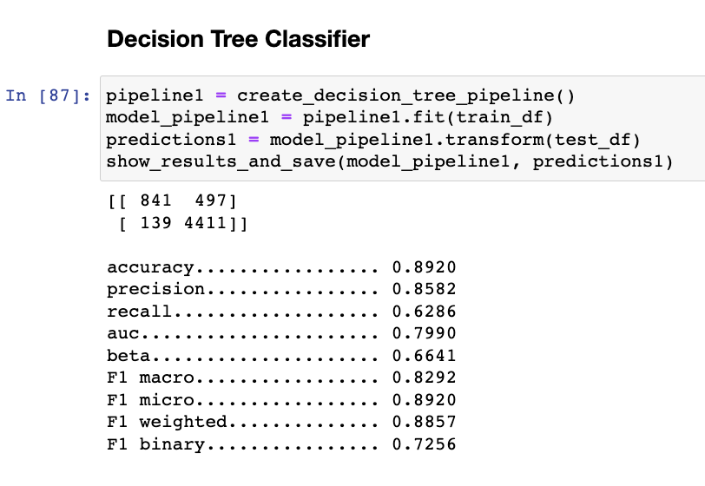
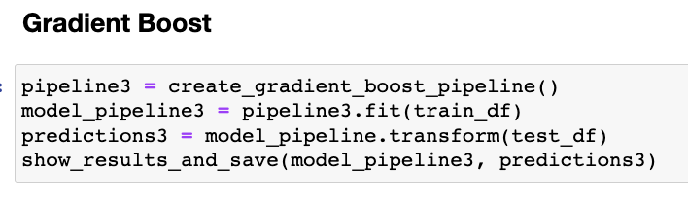
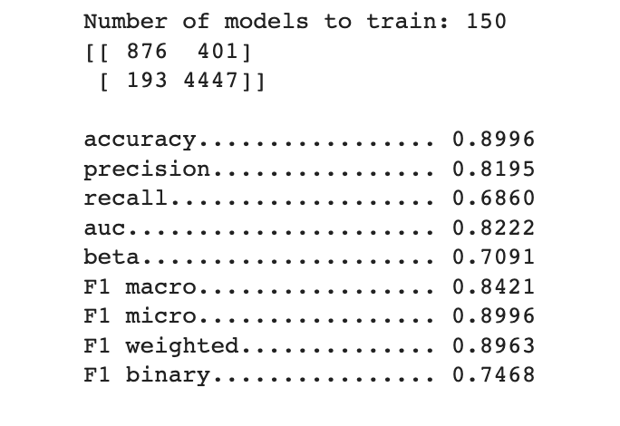
RESULTS

Slide 19

Future Work
Scalable analytics and visualizations using Dask
Deploying a full scale application on amazon cloud using Amazon EMR
Involving deep neural networks to improvise the model performance

Slide 20
THANK YOU!

